Slide 1
Programming with VTK
Week 6: Tk and GUIs
Marcel Jackowski
mjack@noodle.med.yale.edu
http://noodle.med.yale.edu/tcl
http://www.tcl.tk/software/tcltk/8.4.html

Slide 2
VTK & Tcl/Tk Structure Overview
vtk
wish
tk commands
libtk8.4.so (tk84.dll)
tclsh
tcl commands
libtcl8.4.so (tcl84.dll)

Slide 3
What is Tk?
A GUI toolkit implemented with Tcl and C;
It runs on multiple platforms: X/Motif, Win32 GUI, Mac GUI;
It is a freely available open-source package
Its simplicity enables fast development of GUIs with far fewer lines of code;
It allows for easy creation new GUI controls;
Used in commercial packages (e.g. Mayo Clinic’s Analyze)

Slide 4

How easy is to create a button?

Slide 5
Creating a button in X/Motif
1: #include <Xm/PushB.h>
2: int main(int argc, char *argv[])
3: {
4: Widget toplevel, button;
5: XtAppContext app;
6: void button_pushed();
7: XmString label;
8: toplevel = XtVaAppInitialize(&app, “Hello”, NULL, 0,
&argc, argv, NULL, NULL);
9: label = XmStringCreateLocalized(argv[1]);
10: button = XtVaCreateManagedWidgetClass(“mybutton”,
11: xmPushButtonWidgetClass, toplevel,
12: XmNlabelString, label,
13: NULL);
14: XmStringFree(label);
15: XtAddCallback(button, XmNactivateCallback, button_pushed, NULL);
16: XtRealizeWidget(toplevel);
17: XtAppMainLoop(app);
18: }
19: void button_pushed(Widget widget, XtPointer clientdata, XtPointer calldata)
20: {
21: printf(“button pressed!\n”);
22: }

Slide 6
Creating a button In Tcl/Tk
#!/bin/sh
# the next line is executed by the shell, but it is a comment in tcl \
exec wish “$0” “$@”
button .mybutton –text [lindex $argv 0] –command { puts “button pressed!” }
pack .mybutton

Slide 7
Elements in Tk programming
Windows and Widgets
Widgets: windows with a particular look and feel
Class commands: create different widgets
Widget commands: configure widgets
Geometry management commands: place, pack & grid commands
Event bindings

Slide 8

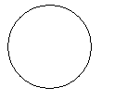

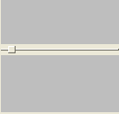
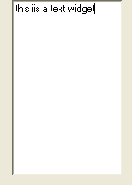

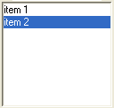
Widget classes
container widgets
regular widgets

Slide 9
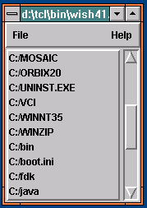
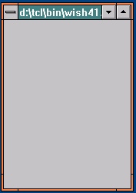
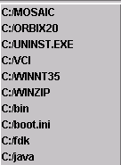
The widget hierarchy
.
.listbox
.menu
.scroll
.menu.file
.menu.help

Slide 10
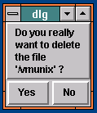
Types of windows
Internal windows
Main window
.
Top-level window
.listbox
.menu
.scroll
.dlg
.menu.file
.menu.help
.dlg.msg
.dlg.no
.dlg.yes

Slide 11
Creating widgets
Each widget has a class: button, scrollbar, listbox, etc;
There’s one class command for each class, used to create instances:
  button .a.b -text Quit -command exit
  scrollbar .x -orient horizontal
class name
configuration options
window name

Slide 12
Configuration options
Defined by each class. For buttons:
-activebackground –disabledforeground -justify -underline
-activeforeground -font -padx -width
-anchor -foreground -pady -wraplength
-background -height -relief
-bitmap -highlightbackground -state
-borderwidth -highlightcolor -takefocus
-command -highlightthickness -text
-cursor -image -textvariable
If not specified in command line, take from option database (option command);
If not in option database, default provided by class.

Slide 13
Widget commands
Tcl command after each widget, named after widget;
Used to reconfigure, manipulate widget:
button .a.b –text “button”
.a.b. configure –relief sunken
listbox .a.l
.a.l insert end “Item 1”
.a.l selection clear 1 end
Widget command is deleted after widget is destroyed;
Widget state should be readable and modifiable anytime.

Slide 14
Geometry management
Widgets don’t control their own positions and sizes: geometry managers do;
They don’t even appear on screen until managed by a geometry manager;
Geometry manager = algorithm for arranging slave windows relative to a master window
Three geometry managers: packer, placer and gridder

Slide 15
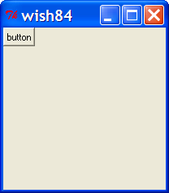
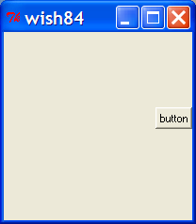
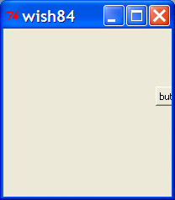
The “place” command
Each slave placed individually relative to its master:
(a)
(b)
(b)
(c)
(a) place .x -x 0 -y 0
(b) place .x -rely 0.4 -relx 1.0 -anchor ne
(c) place .x -rely 0.4 -relx 1.0 -anchor c
= anchor point

Slide 16
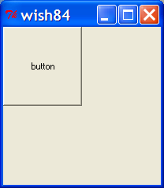
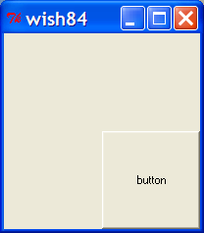
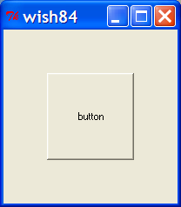
The “place” command
place .x -relwidth .5 -relheight .5
place .x -relwidth .5 -relheight .5 -relx .5 -rely .5
place .x -relwidth .5 -relheight .5 -relx .5 -rely .5 -anchor c

Slide 17
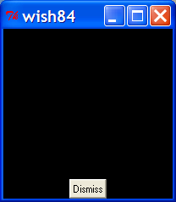
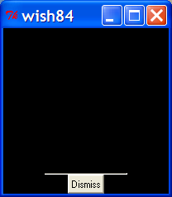
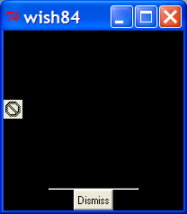
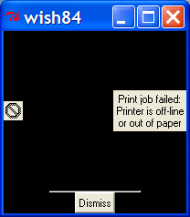
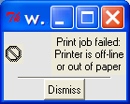
The “pack” command
Packs slaves around edges of master’s cavity:
pack .dismiss -side bottom
pack .sep -side bottom
pack .icon -side left
pack .mesg -side right

Slide 18
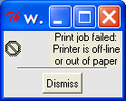
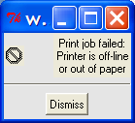
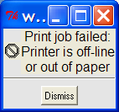
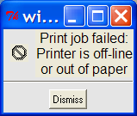
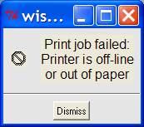
The “pack” command
pack .dismiss -side bottom -pady 4
pack .sep -fill x -pady 4
.mesg configure -font Courier20
pack .icon -side left -padx 8 -pady 8
pack .mesg -side right -padx 8 -pady 8

Slide 19
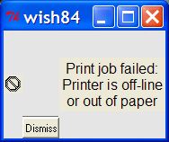
The “pack” command
Changing order of pack commands changes the packing:
pack .icon -side left
pack .mesg -side right
pack .dismiss -side bottom
pack .sep -side bottom

Slide 20
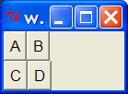
Hierarchical packing
Use additional frames for more complex arrangements:
frame .f1; frame .f2; pack .f1; pack .f2
button .f1.a –text A
button .f1.b –text B
button .f2.c –text C
button .f2.d –text D
pack .f1.a –side left; pack f1.b –side left
pack .f2.c –side left; pack f2.d –side left

Slide 21
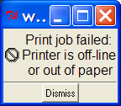
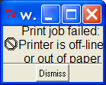


Compressing windows
If a window is resized to be smaller, some widgets may disappear; only those packed early remain visible:
Lesson: Pack most important widgets first!

Slide 22
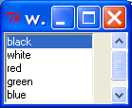
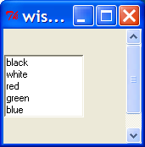
Enlarging windows
scrollbar .sbar -command { .lbox yview }
pack .sbar -side right -fill y
listbox .lbox -width 15 -height 5 -yscrollcommand { .sbar set }
pack .lbox -side left
.lbox insert 0 black white red green blue yellow
.lbox selection set 0

Slide 23
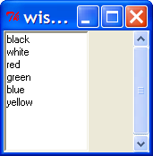
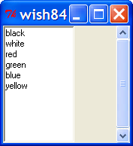
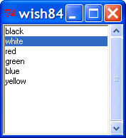
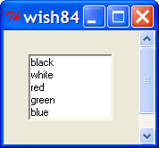
Enlarging windows
Use options “–expand” and “–fill” to enlarge your widgets appropriately:
pack .lbox -side left -fill y
pack .lbox -side left -fill both
pack .lbox -side left -fill both -expand yes
pack .lbox -side left -expand yes -fill none

Slide 24
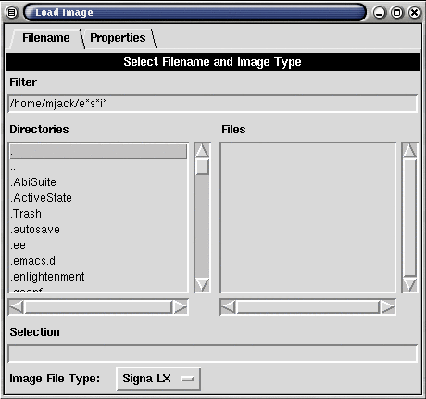
Unpacking widgets
A widget is fully functional even if it is not packed (mapped, realized)!
You can hide or show widgets without destroying them;
Use “pack forget” command.

Slide 25
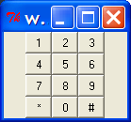
The “grid” command
Instead of packing widgets into a cavity, lay them out on a virtual grid of rows and columns:
button .k0 -text 0 -width 3
button .k1 -text 1 -width 3
button .k2 -text 2 -width 3
button .k3 -text 3 -width 3
. . .
grid .k1 .k2 .k3
grid .k4 .k5 .k6
grid .k7 .k8 .k9
grid .k* .k0 .k#

Slide 26
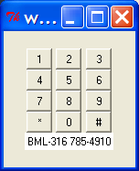
The “grid” command
Use –rowspan and –columnspan to set spans:
label .l -text "BML-316 785-4910" -background white
grid .l -columnspan 3
Use –row and –column to assign specific coordinates to each widget on the grid.

Slide 27
Event processing
Execute Tcl/Tk script
event
Get event from queue
widget
X
Look for script
associated with event
Execute script to
handle the event
Script

Slide 28
Bindings
Associate Tcl scripts with user events:
bind .b <Control-h> {backspace .t}
Window
Event
Script
Can bind events to widgets, classes or tags:
  bind Entry …
  bind all …
  bind .button …

Slide 29
Bindings
Specifying events:
  <Double-Control-ButtonPress-1>
Modifiers
Event Type
Button or Keysym
Modifiers:
Double, Control,Triple, Shift, etc

Slide 30
Bindings
% substitutions in binding scripts:
  Coordinates from event: %x and %y.
  Window: %W.
  Character from event: %A.
  Many more...
Examples:
  bind .c <B1-Motion> {move %x %y}
  bind .t <KeyPress> {insert %A}
  bind all <ButtonPress> { puts %b }

Slide 31
Other Tk commands
Keyboard focus:
  focus .x.y
Window manager commands:
  wm title . “Editing main.c”
  wm geometry . 320x200
  wm iconify .
Deleting windows:
  destroy .top
Window configuration:
  winfo width .x
  winfo children .

Slide 32
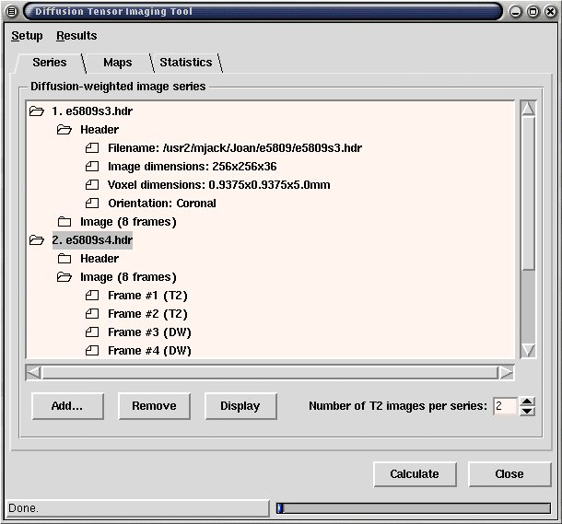
Examples of Tk interfaces

Slide 33
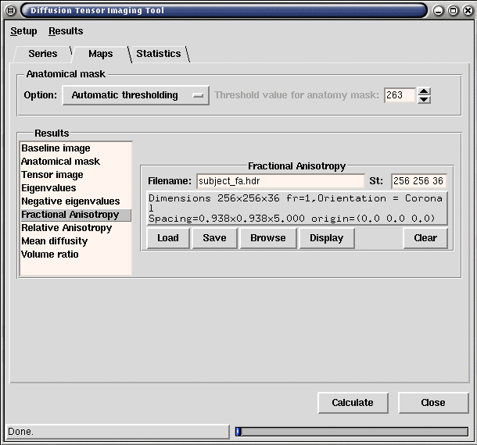
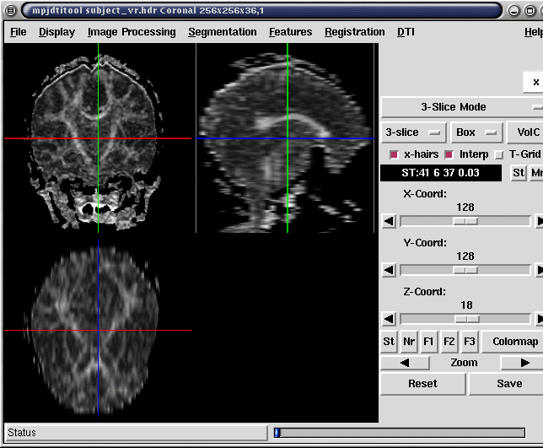
Examples of Tk interfaces

Slide 34
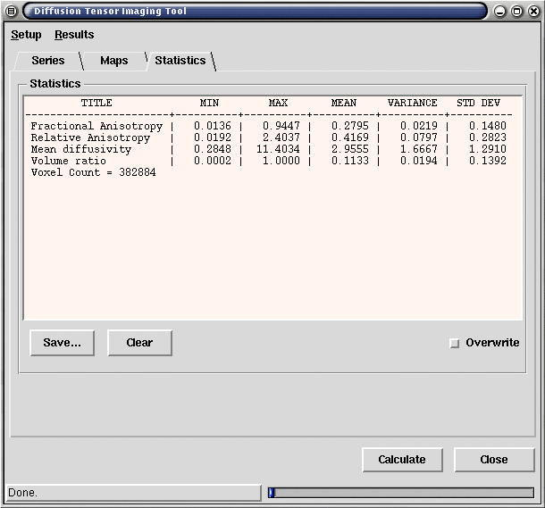
Examples of Tk interfaces

